Slide 1
ETHICS AND GOVERNANCE
MODULE 2: ETHICS
PART A: PROFESSIONAL ETHICS
© COPYRIGHT CPA AUSTRALIA UNLESS OTHERWISE INDICATED
Notes:
Introduce Part A: Professional ethics.
Discuss the following: Ethics essentially deals with what is ‘right’ and ‘wrong’ and how people should act when faced with a particular situation. The Chambers Dictionary defines ethics as ‘a code of behaviour considered correct’.
Professional ethics is the application of ethical principles or frameworks by professionals who have an obligation to act in the interests of those who rely on their services as well as in the best interests of the public
Any professional ethics framework adopted must be understood by members of the profession so that it forms the basis for sound and consistent ethical behaviour. The Accounting Professional and Ethical Standards Board Compiled APES 110 Code of Ethics for Professional Accountants (APESB 2013) is one such framework that we will explore in this module.
A professional accountant is objective, takes full responsibility for the tasks they are entrusted to do, adopts proper planning and control procedures, and possesses the integrity to maintain a professional approach to work.

Slide 2
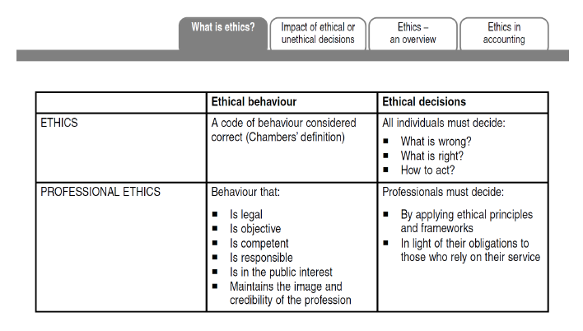
Notes:
Discuss slide content.

Slide 3
ETHICAL RESPONSIBILITIES
The ethical responsibilities of a professional accountant include the following:
the exercise of reasonable skills and diligence;
adherence to a professional code of ethics and standards;
the cautious application of relevant knowledge and experience;
professional skepticism to ensure that any observed discrepancies are properly followed up and investigated.

Slide 4
A PROFESSIONAL ACCOUNTANT
Should be objective
Take full responsibility for the tasks they are entrusted to do
Adopt proper planning
Control procedures
Possesses the integrity to maintain a professional approach to work

Slide 5
IMPACT OF ETHICAL OR UNETHICAL DECISIONS
For example, ethical reporting of a poor financial position may lead to the failure of an organization.
As its stakeholders lose faith, this may result in job losses and financial losses.
Creditors and suppliers may lose monies owed to them as a result of an entity trading when it should have ceased plunging itself further into debt.
Ethical action is still desirable as it is likely to limit losses and lead to faster resolution of issues.
It also respects the rights of all stakeholders involved to know the true state of affairs, despite the negative outcomes for stakeholders.

Slide 6
IMPACT OF ETHICAL OR UNETHICAL DECISIONS
INCENTIVE PAYMENTS OF ADVISER
Some advisers sold products they knew were unsuitable for clients or generated fraudulent documents in order to get commissions
Customers later complained because the cost of poor adviser behavior was financial hardship for the customer and also the financial institution
Financial adviser who lost their jobs regulatory registration because they failed to behave ethically while trying to meet performance criteria set by their institutions.
The behavior of individual or groups of advisers, which was outlined in detail during the royal commission into the financial services sector, let to banks establishing remediation schemes to compensate customers for lost funds and financial distress.

Slide 7
IMPACT OF ETHICAL OR UNETHICAL DECISIONS
Ethics: ‘right’ and ‘wrong’ in a given situation.
Ethical decisions can have a negative effect
Ethical action is desirable as it is likely to limit losses and lead to faster resolution of issues.
Unethical decisions can be considered in relation to the profession and the individual.
Decisions that are not in line with accounting professional standards and legal obligations can result in loss of membership, fines or imprisonment.
Notes:
Discuss slide content.

Slide 8
THE ACCOUNTING WORK ENVIRONMENT
Today’s accountants are respected for their technical and professional competence.
The work is diverse, challenging and intellectually stimulating.
Accountants are often trusted advisers involved in executive management decisions.
There may be high expectations.
Rewards are often associated with responsibility and occasionally with extreme pressure.
Notes:
Discuss slide content.
Ask candidates to answer Question 2.1. Discuss answers. Collect ideas on flipchart.

Slide 9
THE ACCOUNTING WORK ENVIRONMENT
Ethical decisions are those that support the overall objective of serving the interests of society.
Unethical decisions undermine the credibility of the entire profession and increase the likelihood that external regulators will impose restrictions on the profession’s ability to act autonomously and self-regulate.

Slide 10
THE ACCOUNTING WORK ENVIRONMENT
A career in the accounting profession will inevitably involve dealing with many ethical issues.
Key sources of pressure to act contrary to professional ethics include clients, corporate management and conflicts of interest.
The most frequently encountered ethical issues revolve around misleading reporting, fraud, tax evasion, lack of transparency and breaches of confidentiality.

Slide 11
ETHICS IN ACCOUNTING： REAL-LIFE SCENARIOS
Accountants face many difficult ethical situations. It is important to understand that ethical dilemmas can arise throughout your daily professional life;
They do not necessarily involve largescale activities, but can be simple events or decisions that at first glance do not appear unusual.
As accounting work often involves decisions about money and other resources, people will often have strong motivations to act in their own self-interest.

Slide 12
ETHICS IN ACCOUNTING： REAL-LIFE SCENARIOS
This can lead to pressure on the accountant and may make it difficult to act in an objective manner. The current environment of continuous and rapid change, combined with the complexity of accounting work, provides many challenges for accountants.
This creates many types of pressures that are compounded by the requirement to comply with deadlines. Such pressures may create the risk that integrity or competence will be subordinated to expedience.
How to deal with ethical problems, ethical dilemma and conflicts you meet in your daily job?(take examples to explain)

Slide 13
ETHICS AND GOVERNANCE
MODULE 2: ETHICS
PART C: COMPILED APES 110 CODE OF ETHICS FOR PROFESSIONAL ACCOUNTANTS
Notes:
Introduce the topic by explaining that in this section, we move away from the theoretical aspects of ethics to review the Compiled APES 110 Code of Ethics for Professional Accountants, which outlines the ethical principles guiding the behaviour of professional accountants.
In 2005, the International Federation of Accountants (IFAC) issued the Code of Ethics for Professional Accountants (IFAC 2005) as a model that member bodies such as CPA Australia could rely on to provide ethics guidance at a national level.
As a result of this initiative, the Accounting Professional and Ethical Standards Board (APESB) released APES 110 Code of Ethics for Professional Accountants, which was based on the IFAC Code and was initially operational from 1 July 2006. The current version of the APESB Code of Ethics was issued in November 2013. Paragraphs prefixed with the letters ‘AUST’ have been inserted in the APESB Code of Ethics for Australian-specific ethical requirements.
The Code highlights the fundamental principles that apply to all aspects of a professional accountant’s work, and also provides guidance for resolving conflicts of interest and other ethical situations that may arise from time to time.
By joining a profession, members agree to uphold its high ethical standards.

Slide 14
一、美国注册会计师协会（AICPA）
及公众公司会计监督理事会（PCAOB）
二、国际会计师联合会（IFAC）
三、中国注册会计师协会(CICPA)

Slide 15
一、美国注册会计师协会（AICPA）及公众公司会计监督理事会（PCAOB）
美国会计职业道德规范体系的演变过程
1906年美国公共会计师协会（AAPA）建立了一个正式的道德委员会，以制定职业道德标准（即规范体系）
1907年，AAPA以“职业道德”为标题制定了世界上首份成文的职业道德准则。
1917年，AIA于发布了第一份较为全面的职业道德准则，包括八条行为规则 。
1972年5月，美国注册会计师协会（AICPA）准则重述特别委员会向协会理事会提交了修正后的职业道德准则，于1973年3月1日正式生效。
AICPA于1983年10月成立了注册会计师职业行为特别委员会（即安德森委员会, The Anderson Committee）
1988年AICPA对职业道德准则在内容上进行了全面修正，并更名为“职业行为准则”(Code of Professional Conduct)，于1988年1月12日正式采纳。

Slide 16
二、国际会计师联合会（IFAC）
国际会计师联合会 (IFAC) 为了协调国际间职业道德规范，其下属的国际会计师道德准则委员会于1996年首次制定和颁布了《国际职业会计师道德守则》。
不同于AICPA以规则为导向的职业行为守则， IFAC自2004年开始以原则导向（Principle-Based）和概念框架法（Conceptual Frame Approach）制定和修订职业道德守则。

Slide 17
基本原则有合乎逻辑的指南所支持，能避免对没有特别禁止的行为方式的争论；
基本原则简单易懂，几乎能应用于所有的情形，以避免规则导向所带来的刚性过度问题；
原则导向的概念结构能更好应对商业环境和组织的结构的变化；
概念框架法认识到，会计师不能做到完全免于任何威胁，所能做的就是要使对基本原则遵循的威胁降低到不重要的水平。

Slide 18
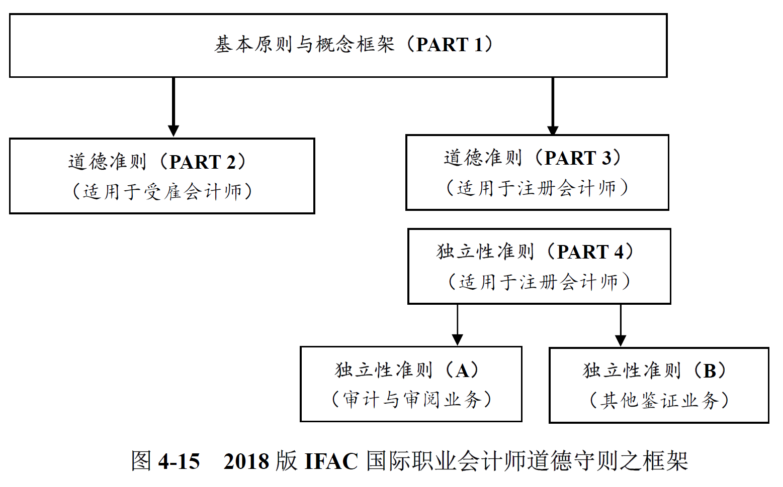
1996—2018年间，IFAC道德准则委员会每隔1-2年对职业道德守则进行一次修订
2018年最新版的《国际职业会计师道德守则》于2019年6月15日开始生效，如下图所示，它主要由四部分的内容构成：

Slide 19
三、中国注册会计师协会(CICPA)
中国会计职业道德规范体系的演变过程
1992年，CICPA依据《中华人民共和国注册会计师条例》颁布了《中国注册会计师职业道德守则（试行）》
1996年，CICPA依据《中国注册会计师法》正式颁布了《中国注册会计师职业道德基本准则》
2002年， CICPA制定和发布了《中国注册会计师职业道德规范指导意见》
2009年， CICPA制定和发布了《中国注册会计师职业道德守则》和《中国注册会计师协会非执业会员职业道德守则》
2014年，CICPA发布《中国注册会计师职业道德守则问题解答》。
2020年1月8日，CICPA发布了《中国注册会计师职业道德守则》和《中国注册会计师协会非执业会员职业道德守则》修订文本的征求意见稿。

Slide 20
三、中国注册会计师协会(CICPA)
与IFAC的两次国际趋同
2009年首次制定发布了与IFAC全面国际趋同的《中国注册会计师职业道德守则》和《中国注册会计师协会非执业会员职业道德守则》
2020年1月8日，为顺应新时代对注册会计师诚信和职业道德水平提出的更高要求，并保持与IFAC职业道德守则的持续动态趋同，CICPA发布了《中国注册会计师职业道德守则》和《中国注册会计师协会非执业会员职业道德守则》修订文本的征求意见稿。其主要修订内容如下图所示：
强化了职业道德概念框架
扩展了现行守则中与“礼品和款待”相关的规定增加了与会计师应对违反法律法规行为相关的规定
增加了与会计师事务所长期审计某一客户相关的规定
修订了与关键审计合伙人轮换及“冷却期”相关的规定
细化了与为审计客户提供非鉴证服务相关的规定
细化了非执业会员在编制和列报信息方面的规定
增加了与非执业会员面临违反职业道德基本原则的压力相关的规定。

Slide 21
THE PUBLIC INTEREST: ETHICS IN PRACTICE
A distinguishing feature of a profession is its commitment to promote and preserve the public interest even if it comes at the expense of its members’, and its own, self-interest.
IFAC has defined public interest as ‘the sum of the benefits that citizens receive from the services provided by the accountancy profession, incorporating the effects of all regulatory measures designed to ensure the quality and provision of such services’ (IFAC 2010).

Slide 22
THE PUBLIC INTEREST: ETHICS IN PRACTICE
IFAC defines ‘interest’ as the ‘responsibilities that professional accountants have to society
Providing sound financial and business reporting to stakeholders, investors, and all parties in the marketplace directly or indirectly impacted by that reporting;
Facilitating the comparability of financial reporting and auditing across different jurisdictions;
Requiring that accounting professionals apply high standards of ethical behavior and professional judgment;
Specifying appropriate educational requirements and qualifications for professional accountants; and
Providing professional accountants in business with the knowledge, judgment and means to contribute to sound corporate governance and performance management for the organizations they serve (IFAC 2010).

Slide 23
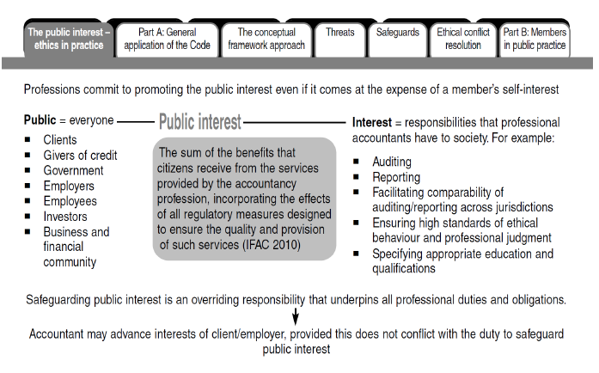

Slide 24
PART A OF THE CODE: GENERAL APPLICATION OF THE CODE
Part A—Fundamental principles
Section 110 Integrity
Section 120 Objectivity
Section 130 Professional competence and due care
Section 140 Confidentiality
Section 150 Professional behaviour
Source: CPA Australia 2016.
Notes:
Discuss slide content.
Ask candidates to read ss. 110—150 of the Code. External to tutorial. Discuss Integrity (s. 110).
Discuss Example 2.8—Moral courage. Discuss Objectivity (s. 120).
Discuss Professional competence and due care (s. 130). Discuss Confidentiality (s. 140).
Discuss Professional behaviour (s. 150).
Ask candidates to answer Question 2.3. Discuss answers.
Ask candidates to complete Case study 2.1—Scott London, former senior partner (audit) at KPMG Los Angeles.
Discuss solutions to Case study tasks.

Slide 25
INTEGRITY
Integrity is an element of character and is essential to the maintenance of public trust.
Integrity in accounting is centered on concepts such as trust, honesty, and honorable and reliable behavior.
Integrity requires strength of character and the courage to pursue one’s convictions, otherwise good intentions may not be sufficient.
As integrity is intrinsically linked with trust, the APESB Code of Ethics imposes an obligation on accountants to be straightforward and honest in professional and business relationships.

Slide 26
INTEGRITY
视诚信为价值实现的必备手段
效用主义
诚信的
道德评价标准
视诚信为应尽的
义务和内在的要求
权力与义务标准
诚信是一种理性的美德
美德伦理学标准
This means that accountants shall not knowingly be associated with reports, returns, communications or other information where they believe that the information.

Slide 27
INTEGRITY
（1）含有严重虚假或误导性的陈述
基于诚信原则，会计师如果认为业务报告、申报资料、沟通函件或其他方面的信息存在下列问题，不得与这些有问题信息发生关联：
（2）含有缺乏充分根据的陈述或信息
（3）存在遗漏或含糊其辞的信息，
而这种遗漏或含糊其辞可能会产生误导
会计师如果注意到已与有问题的信息发生关联，应当采取措施消除关联。针对上述情形，如果会计师按照职业准则的规定出具了恰当的业务报告（例如，在审计业务中，出具恰当的非无保留意见审计报告），则不被视为违反诚信原则。

Slide 28
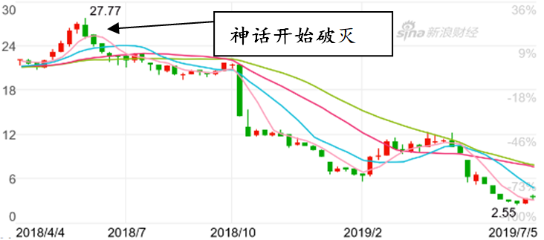
INTEGRITY-Case study
谎言是对诚信原则的最大背叛：康美神话破灭
康美药业自2002年3月上市以来，便一直保持着很高的增长速度，其股价涨幅惊人，最高市值达1500亿元，曾被誉为A股资本市场的一个高增长神话。然而，2018年，康美神话破灭，市值跌去90%。
谎言之一：不存在的300亿货币资金。康美药业通过使用虚假银行单据虚增存款、伪造业务凭证进行收入造假、将不满足会计确认和计量条件的工程项目纳入报表等手段来粉饰财报。经调查，康美医药2017年财报中虚增货币资金高达300亿。
谎言之二：不存在的土地，……
谎言之三：注水的项目，……
谎言之四：隐瞒地产关联交易，虚增无形资产，……
谎言之X：……
如果康美300亿虚假的货币资金往康美的资产负债表、利润表及现金流量表的潜在舞弊账户进行分摊时， 这部谎话连天的“舞弊小说”该有多么的“精彩绝伦”……有限的篇幅，难以诉说惊天的谎言，谎言是对诚信原则的最大背叛！

Slide 29
OBJECTIVITY
Objectivity refers to the state or quality of being true, outside of any individual feelings or interpretations.
Accountants may be exposed to numerous situations that may impair their objectivity in the application of professional judgment.
A member in public practice may feel the need to support a client’s questionable assertions to secure ongoing fees.
Accountants may subordinate the interests of the public to those of the client or themselves, or compromise one client’s interest over another’s.

Slide 30
OBJECTIVITY
客观
公正
不以特定人的角度看待事物
强调以事物本身的属性为标准
不以人的意志而转移；
公平正直
没有偏颇
平等对待各方
客观 公正
坚持客观立场、忠实于事实真相、实现公正公平(包括程序公平与结果公平)
坚持客观立场是基石, 忠实于事实真相是核心, 实现公平公正是目的。
客观公正就是实事求是。

Slide 31
OBJECTIVITY
IFAC（2018）及 CICPA（2020）的职业道德守则规定：
（1）会计师应当遵循客观公正原则，公正处事，实事求是，不得由于偏见、利益冲突或他人的不当影响而损害自己的职业判断。
（2）如果存在可能导致职业判断出现偏差，或对职业判断产生不当影响的情形，会计师不得从事与之相关的专业活动。
会计职业对客观公正原则的选择体现的是公平与正义的道德评判标准。

Slide 32
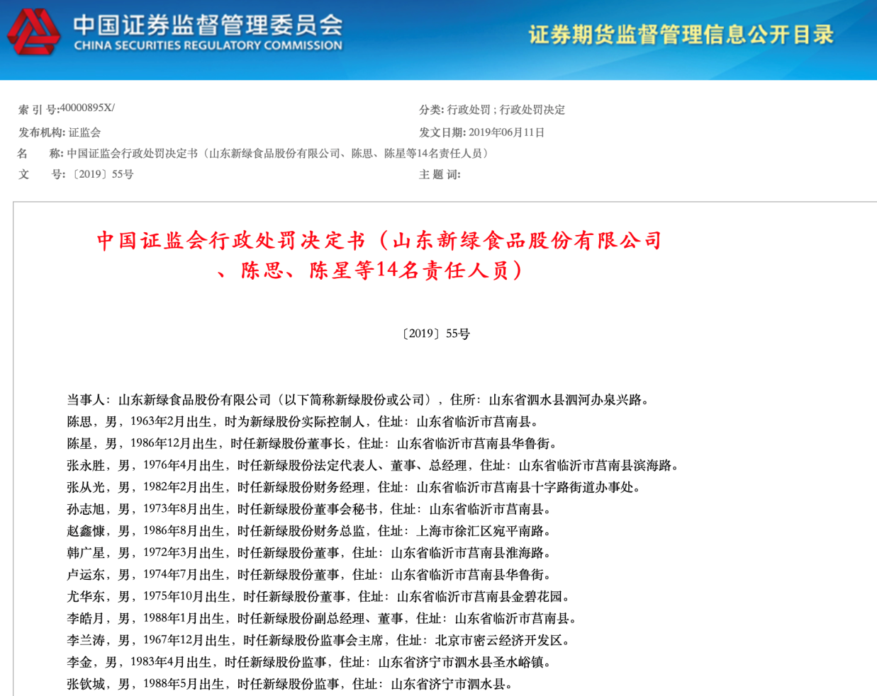
OBJECTIVITY-Case study
因对赌协议而舞弊：大股东眼里的“好会计师”
2019 年 6 月，证监会的一纸行政处罚决定书，揭开了山东新绿食品股份有限公司的一场造假大戏，而其背后的动机，竟是为完成“对赌业绩”。在此前的 2013 与 2015 年，嘉兴硅谷天堂盈祥投资合伙企业(有限合伙)、上海建银国际投资咨询有限公司、方正和生投资有限责任公司、北京方正富邦创融资产管理有限公司、邵某海等以增资控股的形式合计持有山东新绿食品股份公司7.24%的股份，并与公司控股股东及董事长陈星签订业绩对赌协议。协议规定，若公司净利润未达到协议约定的金额，控股股东需向投资方无偿转让其所持有的股权。于是，新绿股份的“舞弊大戏”就此拉开了序幕。

Slide 33
PROFESSIONAL COMPETENCE AND DUE CARE
The first obligation is ‘to maintain professional knowledge and skill at the level required to ensure that clients or employers receive competent professional service’.
The second obligation is ‘to act diligently in accordance with applicable and professional standards when providing Professional Activities’.

Slide 34
PROFESSIONAL COMPETENCE AND DUE CARE
Due care encompasses the responsibility to ‘act in accordance with the requirements of an assignment, carefully, thoroughly and on a timely basis’.
Supervisors have a corresponding duty to ensure that those working under their authority have appropriate training and supervision.
Due care also imposes a condition of compliance with relevant technical and professional requirements.
Such requirements include accounting and auditing standards and other statutory regulations such as taxation laws.

Slide 35
PROFESSIONAL COMPETENCE AND DUE CARE
1993, ICAA (AU), ASCPA (AU) and ICANZ (NZ)
1967 and 1999, AICPA (US)
1998, ACCA (UK)
2000, CGA (CA）
2003, IFAC
2007, CICPA (CN)
2014, CIMA (UK) & AICPA (US)
2019, China Association of Chief Financial Officers

Slide 36
目前，世界各国的会计职业团体在制定会计师能力框架时，大多采用了国际会计师联合会（IFAC）所倡导的基于胜任能力的方法（Competence-Based Approach），并以IFAC的体系与标准作为参照。
职业能力
在真实工作环境下按照既定标准实现其职责的能力
专业胜任能力
一般知识、会计与相关知识、信息技术知识、组织与经营知识
职业知识
通常通过教育与执业经验相结合所获得的，包括智力技能、人际关系技能、交流技能
能力投入
职业技能
包括承诺保持公正、客观、独立，遵照职业准则，关注公众利益和承担社会责任、致力于终身学习
职业价值观

Slide 37
勤勉尽责（Due Care or Diligence），又称应有的职业关注或应有的职业谨慎，是会计执业过程非常重要的一个基本原则，也是在审计准则和司法判决中常见的关键术语与标准。
应有的职业关注这一概念最早源于法庭的判决
（1）拥有与其提供的服务相适应的技能
英国“Cooleyon Tort”案：
“应有的职业关注
（勤勉尽责）”
（2）要小心谨慎地运用其技能
（3）保证忠诚和公正

Slide 38
偏离勤勉尽责导致的法律责任
审计法律责任 | 偏离勤勉尽责（应有的职业谨慎）的程度
普通过失 （Ordinary Negligence） | 在特定情况下缺乏人们期待的合理谨慎。评价审计人员是否缺乏合理谨慎， 则根据在相同情况下其他具有胜任能力的审计人员将会怎样做。
重大过失 （Gross Negligence） | 缺少人们期待的最起码的谨慎，相当于草率行为。
共同过失 (Contributory Negligence) | 受害方自己也未能保持合理的谨慎。
推定欺诈 (Constructive Fraud) | 虽非蓄意欺诈或伤害他人，但却存在极端的或不同寻常的过失。 推定欺诈也可以定义为草率的行为：尽管不是蓄意欺诈报表使用者，但明知没有执行充分审计，却仍然发表了审计意见。
欺 诈 （Fraud） | 对于发生的错报，既知道其虚假性，又进行蓄意欺诈。

Slide 39
过失、欺诈与应有的职业谨慎的关系
没有过失
保持合理的职业谨慎
普通过失
缺乏合理的职业谨慎
重大过失
缺乏起码的职业谨慎
欺 诈
故意的合谋

Slide 40
CONFIDENTIALITY
should respect the confidentiality of information
acquired as a result of professional and business relationships
should not disclose any such information to third parties without proper and specific authority
unless there is a legal or professional right or duty to disclose it.

Slide 41
CONFIDENTIALITY
Disclosure is required by law
Disclosure is permitted by law and is authorized by the client or the employing organization
There is a professional duty or right to disclose, when not prohibited by law:
To comply with the quality review of a professional body
To respond to an inquiry or investigation by a professional or regulatory body
To protect the professional interests of a member in legal proceeding
To comply with technical and professional standards, including ethics requirements.

Slide 42
CONFIDENTIALITY
法律实践上的隐私保护和
商业实践上的商业秘密保护
法理上的私人性（Privacy）之属性
保密原则
要求会计师对职业活动中获知的所有涉密信息保密

Slide 43
CONFIDENTIALITY
受雇单位（客户）
单位会计人员
（注册会计师）
合约关系
基础
相互信赖

Slide 44
CONFIDENTIALITY
职业会计师在接受委托或受雇后不能保守客户或受雇单位的秘密
客户或受雇单位会深信其利益没有得到很好的维护
对职业会计师产生某种程度的不信任
二者之间职业服务合约关系的解体

Slide 45
CONFIDENTIALITY
独立性
透过形式上与精神上的独立性以使其保持诚信与客观公正
提高注册会计师的职业服务质量
最终考量也是公众利益导向
辩证统一、相互依存
保密原则
独立性准则

Slide 46
CONFIDENTIALITY- Case study
偷鸡不成蚀把米:“鸿利智汇”重组信息泄露
鸿利智汇集团股份有限公司成立于2004年，并于2016年年初设立规模约8亿元的车联网并购基金，对外寻找收购标的。当年7月22日，公司与速易网络签订《重组意向书》。
在此次“鸿利智汇”重组案中，张某作为本案并购重组事项审计机构负责人和签字会计师，将其所知悉的客户内幕信息泄露给其妻子何洪涛，后者全仓买入“鸿利智汇”股票280万元，却反而亏损近20%，正可谓是偷鸡不成蚀把米。
此案中，在“鸿利智汇”重组案中担任会计师的张某未做到对职业活动中获知的涉密信息保密，甚至利用因职业关系而获知的涉密信息为自己或第三方谋取利益，严重违反了会计职业道德的保密原则。

Slide 47
PROFESSIONAL BEHAVIOUR
comply with relevant laws ang regulations
avoid any conduct that the member knows
should know might discredit the profession

Slide 48
PROFESSIONAL BEHAVIOUR
In addition to their duty to clients, employers and the public, which comes with a commitment to act in the public interest, accountants also have responsibility to the accounting profession and fellow members.
They must act in a way that promotes the good reputation of the profession and their colleagues.
This includes avoiding exaggerated claims about the services offered, qualifications or experience and avoiding disparaging references or unsubstantiated comparisons to the work of others.

Slide 49
重温50多年前Robert H. Roy 和 James H. MacNeil 关于注册会计师的定义
“注册会计师职业的精要不在于他们的专业知识，也不在于他们的执业经验，而在于这样一些难以捉摸的要素：智慧、洞察力、想象力、判断力、谨慎性及人格上的正直。”
——Robert H. Roy 和 James H. MacNeil ，“Horizon for a Profession”, Journal of Business, 1968, page270-271

Slide 50
PROFESSIONAL BEHAVIOUR
1、职业整体性
该原则主要是透过提升职业会计师的自我职业价值认同以形成共同的职业使命感和职业价值观。
2、正向导向性
通过对职业会计师良好行为的团体评判和褒奖，强化其正向选择的价值判断，同时提高其负向选择的心理成本，这将使职业会计师在面临道德冲突时提高正向行为选择的概率，降低其负向行为选择的可能。

Slide 51
PROFESSIONAL BEHAVIOUR
3、兜底性
在特定的情形下，如果职业会计师面临各项职业道德基本原则之间的内部冲突或权衡困境时，良好职业行为原则可以提供最终的道德抉择标准。
4、综合性
良好的职业行为原则意味着职业会计师应尽可能的高标准履行前述之诚信原则、客观公正原则、专业胜任能力与勤勉尽职原则等。

Slide 52
PROFESSIONAL BEHAVIOUR
IFAC（2018）及CICPA（2020）的职业道德守则规定：
职业会计师不得在明知的情况下，从事任何可能损害诚信原则、客观公正原则或良好职业声誉，从而可能违反职业道德基本原则的业务、职务或活动。
如果一个理性且掌握充分信息的第三方很可能认为某种行为将对良好的职业声誉产生负面影响，则这种行为属于可能损害职业声誉的行为。

Slide 53
IFAC（2018）及CICPA（2020）的职业道德守则规定：
职业会计师在向公众传递信息以及推介自己和工作时，应当客观、真实、得体，不得损害职业形象。职业会计师应当诚实、实事求是，不得有下列行为:
(1)夸大宣传提供的服务、拥有的资质或获得的经验
(2)贬低或无根据地比较他人的工作
如果职业会计师对其行为是否适当存有疑问，可以向会计职业机构或监管部门咨询，但咨询本身并不能减轻职业会计师对良好职业行为应负有的责任与义务。

Slide 54
“损公肥私”：频繁损害职业声誉的副主任会计师
卢剑波，有着“华南第一所”之称的深圳市鹏城会计师事务所之副主任会计师。2013年3月，随着勤上光电审计丑闻的爆出，卢剑波又一次深陷舆论漩涡。由于他在多次IPO保荐业务过程中的不良作风，被市场人士用“忍无可忍”这样的字眼加以形容。
勤上光电远非卢剑波牵扯在内的唯一案件，三川股份、康得新、信邦制药、光韵达等4个IPO项目，皆为卢氏主导。在鹏城所任职期间，卢剑波以其亲属名义注册成立4家投资公司，为其所签字的公司提供IPO前期的财务顾问。为绑定上市公司利益，其不惜让之以部分股权，如三川股份IPO项目，卢剑波将大股东三川集团前副总经理喻加峰、三川股份审计部部长矢进拉入了利益共同体。

Slide 55
“损公肥私”：频繁损害职业声誉的副主任会计师
卢剑波的行为因触及行业底线，遭遇了许多同行的严厉批评。有人曾在微博中公开写道，“曾与某人在某时某地共登某知名大学讲台，我讲规范讲诚信，不鼓励所有企业走上市之路，而某人则讲‘包装’、讲‘设计’，说没有不能上市的企业，只有不懂策划的老板。课后多名学员弃我而从他，至今心存悲凉。”其中的“某人”是谁，自然不言而喻。
卢剑波的种种行为，不仅为其个人招致指责，“卢氏敛财”这种运作方式是典型的以损害行业整体声誉为代价，更是伤了无数恪守良好职业行为原则的同行的心。

Slide 56
THE CONCEPTUAL FRAMEWORK APPROACH
The APESB Code of Ethics adopts a conceptual framework approach to support systematic (or consistent) treatment of ethical issues that may threaten compliance with the fundamental principles of professional conduct.
Threats (s. 100.12)
Safeguards (ss. 100.13–100.16)
Ethical conflict resolution (ss. 100.19–100.24)
Source: Dellaportas, S., Alagiah, R., Gibson, K., Leung, P., Hutchinson, M. & Van Homrigh, D. 2005, Ethics, Governance and Accountability: A Professional Perspective, John Wiley & Sons, Milton, Queensland, p. 75.
Notes:
Note: The concepts from Table 2.4 have received a high level of queries on the candidate forum, and are considered to be an area of difficulty for some candidates.
Discuss slide content.
Explain the Conceptual Framework Approach.
Ask candidates to read ss. 100.6−100.11 of the Code to familiarise themselves with the conceptual framework approach. External to tutorial. Discuss Table 2.3—Threats to fundamental principles.
Discuss Example 2.9—Intimidation—a threat to the fundamental principles.
Discuss Table 2.4—Examples of threats—accountants in public practice and business. Discuss Safeguards (ss. 100.13–100.16). Ask candidates to read this section.

Slide 57
THE CONCEPTUAL FRAMEWORK APPROACH
The conceptual framework approach requires members to identify, evaluate and respond to any identified threat that may compromise compliance with the fundamental principles.
If the identified threats are not insignificant, members must apply safeguards to eliminate such threats or reduce them to an acceptable level, so that compliance is no longer compromised.
If members are unable to implement appropriate safeguards, they should either decline or discontinue the specific professional service involved, or consider resigning from the client or employer.

Slide 58
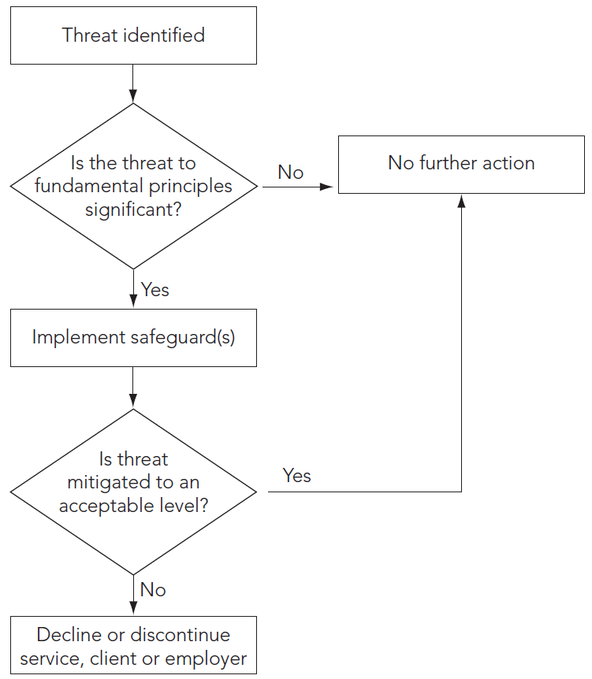
THE CONCEPTUAL FRAMEWORK APPROACH

Slide 59
THE CONCEPTUAL FRAMEWORK APPROACH
Rule-based codes: require adherence to a set of specific rules in terms of the specific actions that should or should not be taken.
The problem with a code that is entirely rules-based is that it becomes too prescriptive and too voluminous to be of practical use.
A principles-based approach to decision-making, is more likely to evaluate whether an act or decision accords with the concept underlying the principle or whether it could bring the profession into disrepute.
For a principles-based code to be effective, it is useful to take a blended approach containing a mix of broad principles and more specific guidance, which together show how the conceptual framework applies in specific situations.

Slide 60
THE CONCEPTUAL FRAMEWORK APPROACH
对于财务会计而言，其基本逻辑顺序为：财务会计概念框架（CF）——基本会计原则(Principles)——具体会计准则(Standards) 或规则 （Rules）；
对于职业道德而言，其基本逻辑顺序则为：职业道德基本原则(Principles)——职业道德概念框架（CF）——职业道德准则 (Standards)或规则（Rules）。

Slide 61
评价不利影响
应对不利影响
识别不利影响
所有职业会计师的概念均包括以下三个核心概念：识别不利影响（Identifying Threats）、评价不利影响（Evaluating Threats）与应对不利影响（Addressing Threats）
职业道德概念框架还隐含着深刻的风险导向（Risk-Oriented）逻辑，即要求职业会计师以“可能影响基本原则得到有效遵循的潜在风险”为主线，对这些潜在风险进行识别、评估与应对。在操作层面上，职业道德概念框架又体现了“防护法” (Safeguards Approach)的思维，即职业会计师应用概念框架的目的是为了寻找有效的防护措施，以消除不利影响或将其降低到可接受的水平。

Slide 62
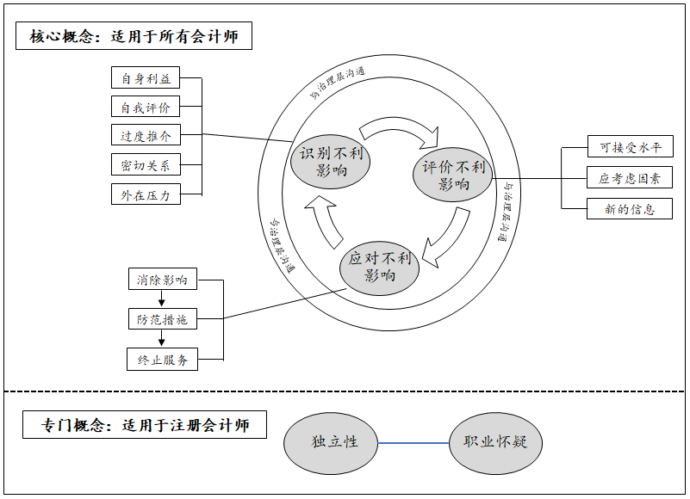
IFAC（2018）所发布的《国际会计师职业道德守则》将会计职业道德概念框架所包含的概念要素分为两部分，即适用于所有会计师的概念体系及针对注册会计师的专门概念。
上半部分则是CICPA（2020）所给出的概念框架构成要素。

Slide 63
THREATS IDENTIFICATION
Threats may be created by a broad range of relationships and circumstances. When a relationship or circumstance creates a threat, such a threat could compromise, or could be perceived to compromise, a member’s compliance with the fundamental principles.
Such a circumstance or relationship may create more than one threat, and a threat may affect compliance with more than one fundamental principle (s. 100.12). The specific nature of each threat will depend on the particular circumstances in which it arises, and some may be difficult to categories.

Slide 64
1
2
3
4
5
从制度变迁的意义上来讲，审计模式的演变可以视为一个制度变迁的过程
因自身利益产生的不利影响
因自我评价产生的不利影响
因过度推介产生的不利影响
因密切关系产生的不利影响
因外在压力产生的不利影响

Slide 65
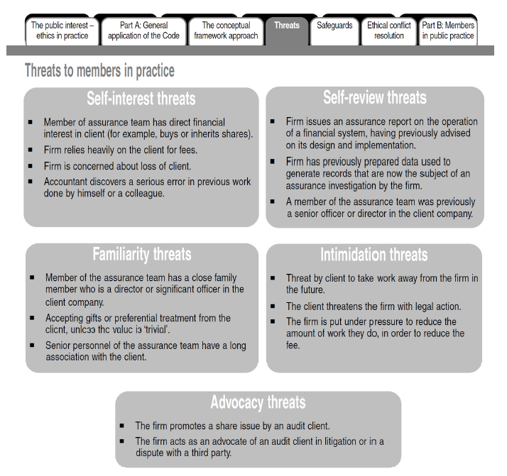

Slide 66
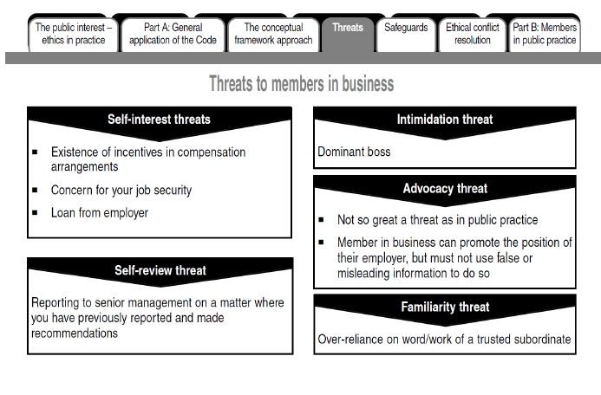

Slide 67
EVALUATION THREATS-self-interest threat
直接经济利益是指注册会计师个人或其控制的实体直接拥有与客户相关的经济利益，或通过投资工具拥有与客户相关的经济利益并且有能力控制这些投资工具或影响其投资决策。
间接经济利益是指注册会计师个人或其控制的实体通过投资工具拥有与客户相关的经济利益，但没有能力控制这些投资工具，或影响其投资决策。
财务上的个人利益
其他方面的个人利益
情感上的个人利益

Slide 68
EVALUATION THREATS-self-review threat
职业会计师在审查自己的工作或同一单位其他同事的工作
难以保持客观
可能不恰当地评价这些以往的判断或结论
美国最大能源交易商安然公司破产案引起了巨大震荡。
一方面，安然公司的许多高层人员为安达信的前雇员，包括首席财务官、首席会计主管和公司发展部副总经理等，他们之间密切关系至少有损于独立性。
另一方面，一直为安然提供审计和咨询服务的安达信每天有100多名雇员专门为安然服务，每个星期从安然收取100多万美元的服务费。

Slide 69
EVALUATION THREATS-advocacy threat
比如，当注册会计师为审计客户承销证券时，这种不利影响就会产生
因过度推介产生的不利影响，是指会计师倾向客户或所受雇单位的立场，导致该会计师的客观公正原则受到损害而产生的不利影响。
当受雇单位与第三方发生诉讼或纠纷或应对反倾销辩护时，其内部会计人员担任受雇单位的辩护人，此时也会产生过度推介的不利影响

Slide 70
EVALUATION THREATS-Familiarity threat
当注册会计师对审计客户非常熟悉或信任
轻易接受其观点
可能会对客户的认定未能保持足够的怀疑
因密切关系产生的不利影响，是指会计师由于与客户或所在单位存在长期或密切的关系，导致过于偏向客户或所在单位的利益或过于认可客户或所在单位的工作，从而对遵循职业道德基本原则所产生的不利影响。

Slide 71
EVALUATION THREATS-intimidation threat
因外在压力产生的不利影响，是指职业会计师迫于实际存在的或可感知到的压力，导致无法客观行事而对遵循职业道德基本原则产生的不利影响。
《人民的名义》之剧版
《人民的名义》之现实版
2017年5月，从开播到结局一直处于热议中的反腐剧《人民的名义》剧终。正义的化身“侯局长”终于手握利剑将“一窝贪官”绳之以法。但很多会计人也为自己捏了一把汗。剧中，两名会计人员被先后“除掉”了，一名是山水集团的会计，一名是大风厂的会计。
2003年3月，谢桂云与其他4名股东签订了合股经营合同，成立涟源市创新铸铁有限公司，由谢桂云任总经理兼法人代表。在高层会议上，曾有股东提出做两套账的做法，一套真实账，做一套虚假“税务账”。。面对此种压力，廖某依旧谢桂云要求会计师廖某执行这一做法，并以辞退作为威胁依法行事，回复称“不会做”，并予以拒绝。之后，该公司又专门聘请了兼职会计田友明做“税务账”。

Slide 72
可接受的不利影响水平（Acceptable Level）
IFAC（2018）及CICPA（2020）均要求职业会计师应当评价该不利影响的严重程度是否处于可接受的水平。
评价时应考虑的相关因素
（Factors Relevant in Evaluating）
三个方面
考虑新信息或者事实和情况的变化
（Consideration of New Information or Changes in Facts and Circumstances）

Slide 73
（1）消除产生不利影响的情形，包括利益或关系
职业会计师应当运用职业判断，确定如何应对超出可接受水平的不利影响，包括以下三种基本的应对方式：
（2）采取可行的防范措施将不利影响降低至可接受的水平
（3）拒绝或终止特定的职业活动

Slide 74
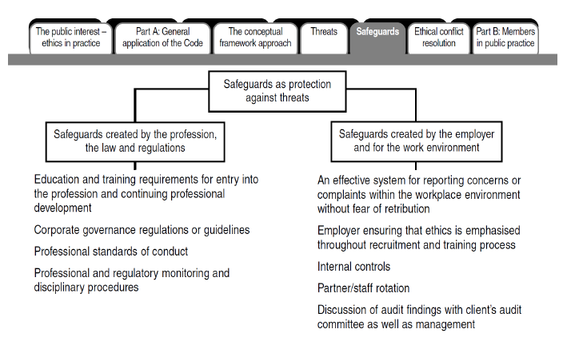

Slide 75
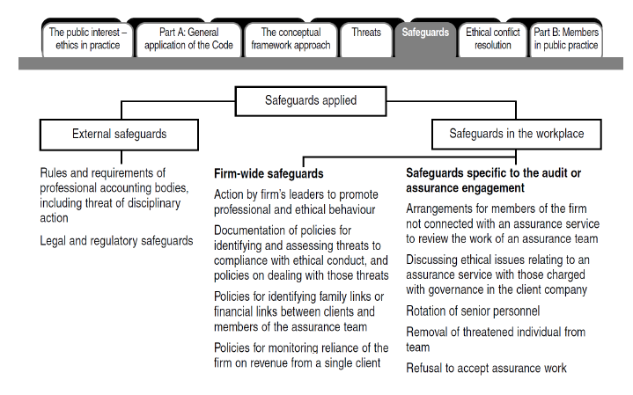

Slide 77
ETHICS AND GOVERNANCE
MODULE 2: ETHICS
PART D: ETHICAL DECISION-MAKING
Notes:
Introduce Part D. In this section we consider how ethical decisions should be made.

Slide 78
Ethical decision-making
Decision-making is the thought process necessary to select a course of action to achieve a desired result from among two or more options. Put more simply, it involves making a purposeful choice from a set of alternatives.
Decision-making with ethical implications is simply another form of problem-solving. The chief difference between decision-making and ethical decision-making is the consideration of ethical values and implications in the selection of an appropriate alternative.
Therefore, ethical decision-making is defined as reaching a responsible decision after taking into consideration the general ethical beliefs of the individual, the ethical implications of a course of action, and the norms and rules pertaining to the circumstances of the situation

Slide 79
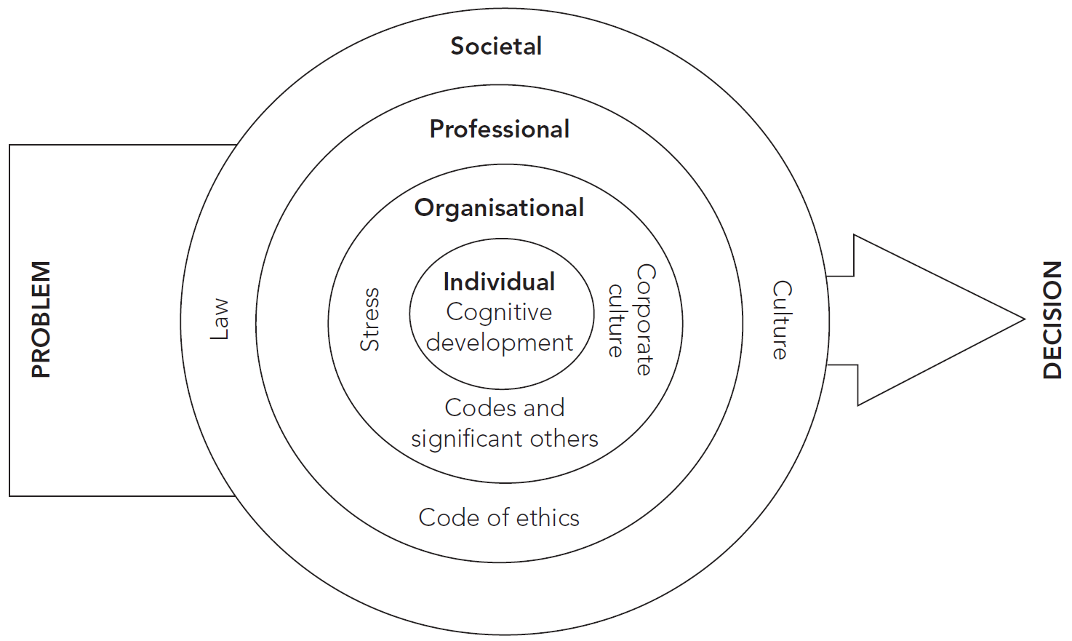
INFLUENCES ON AN INDIVIDUAL’S DECISION
Source: CPA Australia 2015.
Notes:
Discuss slide content.
This is important for candidates because it stresses to the individual the responsibility and context of influencing factors involved in ethical decision-making.
The diagram illustrates the various factors that influence decision-making.
Most decisions are influenced predominantly by an individual’s cognitive processes (the reasoning used in making a decision). However, other factors also have an influence. In general, the intensity with which these variables affect decision-making is directly related to their proximity to the individual.
Ask candidates to consider examples of the various factors that may affect decisions.
Discuss Example 2.11—Whistleblowing.
Emphasise each ‘layer’ of influence in the diagram. Note: The individual is placed at the hub of the process.

Slide 80
INDIVIDUAL FACTORS
A person’s decision-making is most influenced by their cognitive ability to judge the ethical rightness of a situation.
People have different levels of moral development.
Some people are selfish and may only act in the right way out of fear of punishment.
Others may act appropriately to gain additional benefits from others.
Notes:
Discuss slide content.

Slide 81
INDIVIDUAL FACTORS
Another factor influencing a person’s decision-making is their development of ethical courage. Ethical courage can be developed over time
Ethical courage is the level of courage a person demonstrates in order to make difficult decisions and act upon these decisions. Acting with courage means being straightforward and honest in all professional and business relationships.
Accountants face difficult situations and often have to make decisions, requiring them to choose between the competing interests of clients, employers and the public.

Slide 82
Reference reading in module 1: Stage of Moral Development 关于劳伦斯道德发展阶段论

Slide 83
ORGANISATIONAL FACTORS
Corporate culture: patterns and rules that govern the behaviour of an organisation and its employees.
A culture that lacks written policies and codes of ethics, and accepts dishonesty and unethical conduct, may strongly influence employees’ ethical decision-making.
Even honest employees behave in deviant ways if their environment, or management, encourages it.
An ethical culture is more likely to lead to ethical employee behaviour.
The ethical culture of an organisation is subject to the actions of management.
Notes:
Discuss slide content.
Discuss Example 2.12—Poor ethical cultures cause significant trouble. Ask candidates to complete activity in small groups.
Discuss Example 2.13—Omega Finance. Ask candidates to complete activity.
Ask candidates to answer Question 2.9. Discuss answers.

Slide 84
ORGANISATIONAL FACTORS
Top-tier management is considered the most influential factor in setting organisational values, which in turn determines the culture that influences members’ behaviour.
The actions and decisions of management have a significant contribution to the culture and ethical approach of an organisation. Schein (2004) identifies six areas in which such actions and decisions are most relevant:
What leaders pay attention to, measure, and control on a regular basis.
How leaders react to critical incidents and organizational crises.
How leaders allocate resources.
Deliberate role modelling, teaching, and coaching.
How leaders allocate rewards and status.
How leaders recruit, select, promote, and excommunicate (Schein 2004, p. 246).

Slide 85
PROFESSIONAL FACTORS
Accountants are influenced by their membership of a profession.
The extent of the influence on decision-making is dependent on the effectiveness of the Code.
According to the Code, members in business ‘may hold a senior position within an organisation.
The more senior the position, the greater will be the ability and opportunity to influence events, practices and attitudes
Notes:
Discuss slide content.
Ask candidates to answer Question 2.10. Discuss answers. Collect answers in a flipchart.

Slide 86
SOCIETAL FACTORS
Law and regulation
Laws and regulations are rules established by the community through the legislature. They prohibit certain actions.
Laws generally reflect societal attitudes; for most people they have minimal impact on ethical behaviour.
Culture
In ethics, cultural values have a major influence in determining what is considered proper and ethical.
Ethical relativism holds that ethical behaviour is relative to the norms of one’s culture.
Notes:
Discuss slide content.
Ask candidates to answer Question 2.11. Discuss answers.
Ask candidates to answer Question 2.12. Discuss answers.

Slide 87
ETHICAL DECISION-MAKING MODELS
Most people rely on personal insight, intuition, judgment and experience to make decisions.
A simplistic approach is to use an unstructured base for making decisions (heuristic approach).
This may lead to solutions that are merely satisfactory or adequate.
A more systematic approach is to use structured models of decision-making.
There is no perfect or correct model.
The following models should reduce the possibility of an incorrect or inappropriate decision.
Notes:
Discuss slide content.

Slide 88
PHILOSOPHICAL MODEL OF ETHICAL DECISION-MAKING
For each alternative course of action, ask:
Do the benefits outweigh the harms to oneself?
Do the benefits outweigh the harms to others?
Are the rights of individual stakeholders considered and respected?
Are the benefits and burdens justly distributed?
This approach provides a framework within which ethical issues can be identified, analysed and resolved.
Its strength lies in the application of multiple theories to an ethical dilemma, rather than a single theory.
Notes:
Discuss slide content.
Ask candidates to answer Question 2.13, in small groups. Discuss answers. Refer to solution in the Study guide.
Discuss Example 2.14—DIGFX, in small groups. Discuss answers. Refer to solution in the Study guide.

Slide 89
Seven-step model
1.What are the facts of the case?
2.What are the ethical issues in the case?
3.What are the norms, principles and values related to the case?
4.What are the alternative courses of action?
5.What is the best course of action that is consistent with the norms, principles and values identified in Step 3?
6.What are the consequences of each possible course of action?
7.What is the decision?

